Slide 1
Consensus & Controversy
Vivek Garg
CSVTU Bhilai

Slide 2
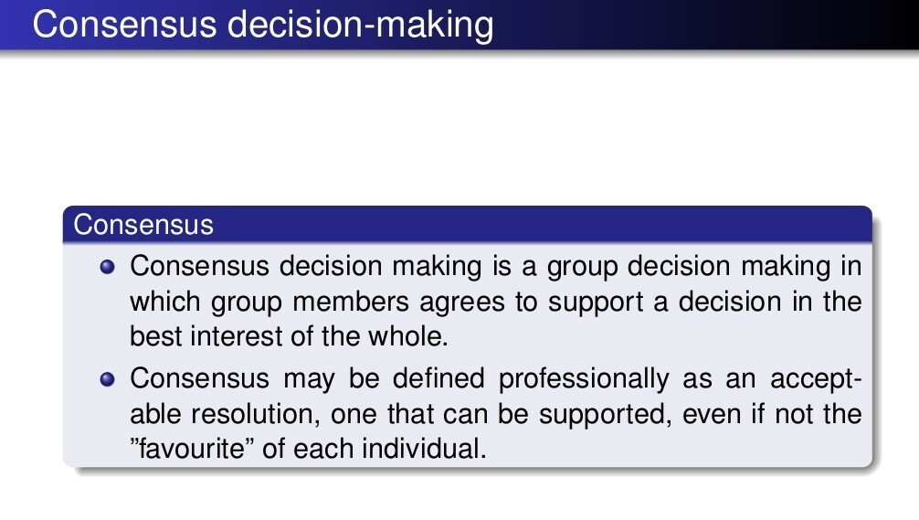

Slide 3
